Slide 1
PRIM'S ALGORITHM

Slide 2

MINIMUM SPANNING TREE

Slide 3
Definition
A Minimum Spanning Tree (MST) is a subgraph of an undirected graph such that the subgraph spans (includes) all nodes, is connected, is acyclic, and has minimum total edge weight

Slide 4

GREEDY ALGORITHM

Slide 5
Algorithm Characteristics
Prim's Algorithms work with undirected graphs
It work with weighted and unweighted graphs but are more interesting when edges are weighted
It is greedy algorithms that produce optimal solutions

Slide 6
Walk-Through
2
Initialize array
F
3
C
 | K | d_{v} | p_{v}
A | F | ∞ | −
B | F | ∞ | −
C | F | ∞ | −
D | F | ∞ | −
E | F | ∞ | −
F | F | ∞ | −
G | F | ∞ | −
H | F | ∞ | −
10
A
7
3
8
4
4
B
18
D
9
10
H
2
25
3
G
E
7

Slide 7
2
Start with any node, say D
F
3
C
 | K | d_{v} | p_{v}
A
B
C
D | T | 0 | −
E
F
G
H
10
A
7
3
8
4
4
B
18
D
9
10
H
2
25
3
G
E
7

Slide 8
2
Update distances of adjacent, unselected nodes
F
3
C
 | K | d_{v} | p_{v}
A
B
C |  | 3 | D
D | T | 0 | −
E |  | 25 | D
F |  | 18 | D
G |  | 2 | D
H
10
A
7
3
8
4
4
B
18
D
9
10
H
2
25
3
G
E
7

Slide 9
2
Select node with minimum distance
F
3
C
 | K | d_{v} | p_{v}
A
B
C |  | 3 | D
D | T | 0 | −
E |  | 25 | D
F |  | 18 | D
G | T | 2 | D
H
10
A
7
3
8
4
4
B
18
D
9
10
H
2
25
3
G
E
7

Slide 10
2
Update distances of adjacent, unselected nodes
F
3
C
 | K | d_{v} | p_{v}
A
B
C |  | 3 | D
D | T | 0 | −
E |  | 7 | G
F |  | 18 | D
G | T | 2 | D
H |  | 3 | G
10
A
7
3
8
4
4
B
18
D
9
10
H
2
25
3
G
E
7

Slide 11
2
Select node with minimum distance
F
3
C
 | K | d_{v} | p_{v}
A
B
C | T | 3 | D
D | T | 0 | −
E |  | 7 | G
F |  | 18 | D
G | T | 2 | D
H |  | 3 | G
10
A
7
3
8
4
4
B
18
D
9
10
H
2
25
3
G
E
7

Slide 12
2
Update distances of adjacent, unselected nodes
F
3
C
 | K | d_{v} | p_{v}
A
B |  | 4 | C
C | T | 3 | D
D | T | 0 | −
E |  | 7 | G
F |  | 3 | C
G | T | 2 | D
H |  | 3 | G
10
A
7
3
8
4
4
B
18
D
9
10
H
2
25
3
G
E
7

Slide 13
2
Select node with minimum distance
F
3
C
 | K | d_{v} | p_{v}
A
B |  | 4 | C
C | T | 3 | D
D | T | 0 | −
E |  | 7 | G
F | T | 3 | C
G | T | 2 | D
H |  | 3 | G
10
A
7
3
8
4
4
B
18
D
9
10
H
2
25
3
G
E
7

Slide 14
2
Update distances of adjacent, unselected nodes
F
3
C
 | K | d_{v} | p_{v}
A |  | 10 | F
B |  | 4 | C
C | T | 3 | D
D | T | 0 | −
E |  | 2 | F
F | T | 3 | C
G | T | 2 | D
H |  | 3 | G
10
A
7
3
8
4
4
B
18
D
9
10
H
2
25
3
G
E
7

Slide 15
2
Select node with minimum distance
F
3
C
 | K | d_{v} | p_{v}
A |  | 10 | F
B |  | 4 | C
C | T | 3 | D
D | T | 0 | −
E | T | 2 | F
F | T | 3 | C
G | T | 2 | D
H |  | 3 | G
10
A
7
3
8
4
4
B
18
D
9
10
H
2
25
3
G
E
7

Slide 16
2
Update distances of adjacent, unselected nodes
F
3
C
 | K | d_{v} | p_{v}
A |  | 10 | F
B |  | 4 | C
C | T | 3 | D
D | T | 0 | −
E | T | 2 | F
F | T | 3 | C
G | T | 2 | D
H |  | 3 | G
10
A
7
3
8
4
4
B
18
D
9
10
H
2
25
3
G
E
7
Table entries unchanged

Slide 17
2
Select node with minimum distance
F
3
C
 | K | d_{v} | p_{v}
A |  | 10 | F
B |  | 4 | C
C | T | 3 | D
D | T | 0 | −
E | T | 2 | F
F | T | 3 | C
G | T | 2 | D
H | T | 3 | G
10
A
7
3
8
4
4
B
18
D
9
10
H
2
25
3
G
E
7

Slide 18
2
Update distances of adjacent, unselected nodes
F
3
C
 | K | d_{v} | p_{v}
A |  | 4 | H
B |  | 4 | C
C | T | 3 | D
D | T | 0 | −
E | T | 2 | F
F | T | 3 | C
G | T | 2 | D
H | T | 3 | G
10
A
7
3
8
4
4
B
18
D
9
10
H
2
25
3
G
E
7

Slide 19
2
Select node with minimum distance
F
3
C
 | K | d_{v} | p_{v}
A | T | 4 | H
B |  | 4 | C
C | T | 3 | D
D | T | 0 | −
E | T | 2 | F
F | T | 3 | C
G | T | 2 | D
H | T | 3 | G
10
A
7
3
8
4
4
B
18
D
9
10
H
2
25
3
G
E
7

Slide 20
2
Update distances of adjacent, unselected nodes
F
3
C
 | K | d_{v} | p_{v}
A | T | 4 | H
B |  | 4 | C
C | T | 3 | D
D | T | 0 | −
E | T | 2 | F
F | T | 3 | C
G | T | 2 | D
H | T | 3 | G
10
A
7
3
8
4
4
B
18
D
9
10
H
2
25
3
G
E
7
Table entries unchanged

Slide 21
2
Select node with minimum distance
F
3
C
 | K | d_{v} | p_{v}
A | T | 4 | H
B | T | 4 | C
C | T | 3 | D
D | T | 0 | −
E | T | 2 | F
F | T | 3 | C
G | T | 2 | D
H | T | 3 | G
10
A
7
3
8
4
4
B
18
D
9
10
H
2
25
3
G
E
7

Slide 22
2
Cost of Minimum Spanning Tree = Σ d_{v} = 21
F
3
C
 | K | d_{v} | p_{v}
A | T | 4 | H
B | T | 4 | C
C | T | 3 | D
D | T | 0 | −
E | T | 2 | F
F | T | 3 | C
G | T | 2 | D
H | T | 3 | G
A
3
4
4
B
D
H
2
3
G
E
Done

Slide 23
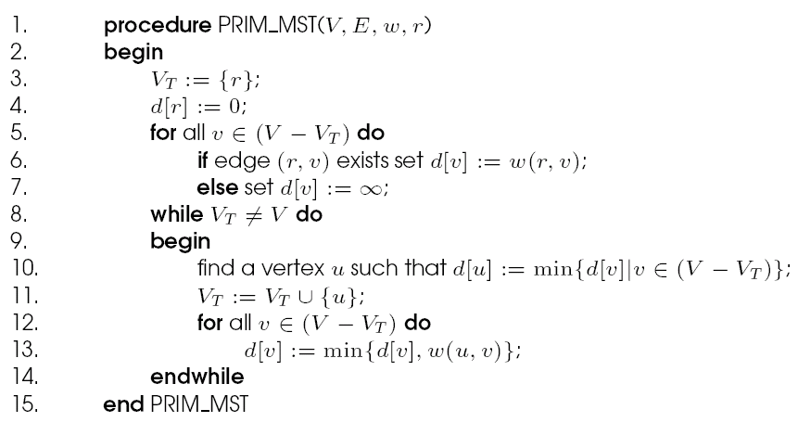
Minimum Spanning Tree: Prim's Algorithm
Prim's sequential minimum spanning tree algorithm.

Slide 24
Prim's Algorithm: Parallel Formulation
The algorithm works in n outer iterations - it is hard to execute these iterations concurrently.
The inner loop is relatively easy to parallelize. Let p be the number of processes, and let n be the number of vertices.
The adjacency matrix is partitioned in a 1-D block fashion, with distance vector d partitioned accordingly.
In each step, a processor selects the locally closest node, followed by a global reduction to select globally closest node.
This node is inserted into MST, and the choice broadcast to all processors.
Each processor updates its part of the d vector locally.

Slide 25
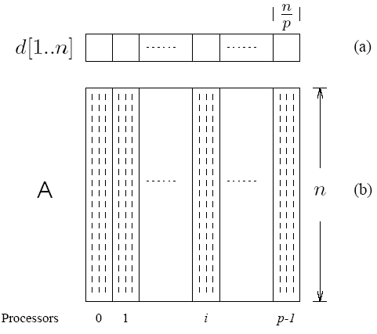
Prim's Algorithm: Parallel Formulation
The partitioning of the distance array d and the adjacency matrix A among p processes.

Slide 26
Prim's Algorithm: Parallel Formulation
The cost to select the minimum entry is O(n/p + log p).
The cost of a broadcast is O(log p).
The cost of local updation of the d vector is O(n/p).
The parallel time per iteration is O(n/p + log p).
The total parallel time is given by O(n²/p + n log p).
The corresponding isoefficiency is O(p²log²p).

Slide 27


